Slide 1


Computer international technology
ABOUT SOME INFORMATION:
Ms. Word
Excel

Slide 2

About some information (cv)
Contact Information: This should be at the very top. Include your full name, phone number, professional email address, and a link to your LinkedIn profile (if you have one). Make sure your email address is professional (e.g., firstname.lastname@email.com).
Professional Summary/Objective: Start with a brief, compelling summary. A professional summary (for experienced candidates) highlights your key skills and achievements.
A career objective: (for those with less experience) states your career goals and what you hope to contribute.
Work Experience: List your jobs in reverse chronological order, starting with your most recent role. For each position, include your job title, company name, location, and employment dates.

Slide 3
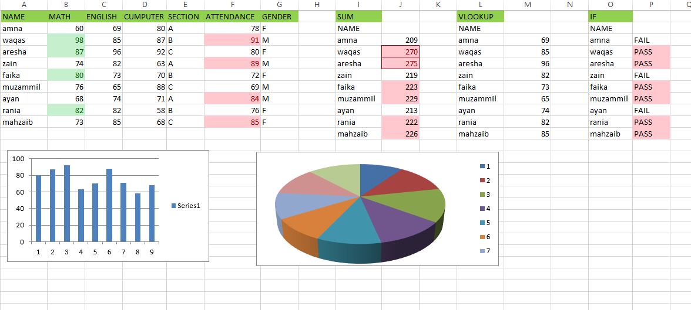
About excel sheet work
Using Some Formulas On Excel Sheet:
SUM IN Excel:
Sum add to number.
VLOOKUP IN EXCEL:
Vlookup in excel is used to lookup a certain value in any column.
IF IN EXCEL:
If in excel is used to test a cindition and return different value for True or False.

Slide 4
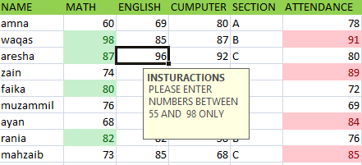

DATA VALIDATION IN EXCEL: here i have data validation and restricted to only enter a number between 55 to 98 and when he enters anther number he gets an error.
CONDITIONAL FORMATTING IN EXCEL: conditional formatting is used to highlight cells based on specific.

Slide 5

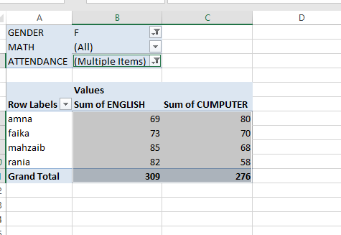
Pivot table
ABOUT PIVOT TABLE:
A pivot table is used to summarize and analyze data quickly.
It allows pivoting (rearranging rows and columns) to view data from different perspectives.
With filters, you can focus on specific part of the dataset.

Slide 6


“THANKS FOR WATCHING”
“MY PRESENTATION”

